Slide 1
Evan Nagy CS-250 Final

Slide 2
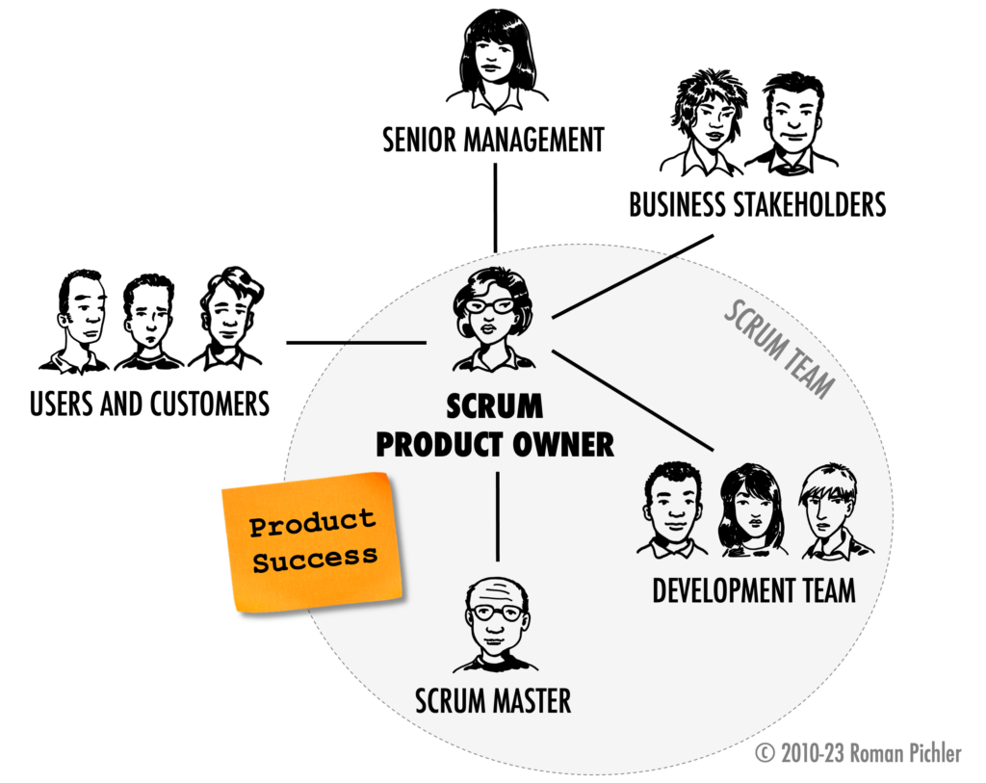
What is a Scrum Team?
A Scrum Team is a small Group of individuals that work Collaboratively to deliver a product.
The main Features of this team are:
Agile Development
Incremental Sprints
Daily Scrums
Scrum Events

Slide 3
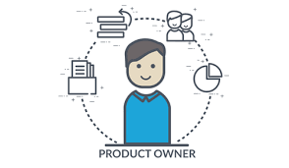
Product Owner
Responsibilities:
Meeting with The Stakeholders
Gathering Requirements
Maintaining the Product Backlog
Communicating with the Scrum Master and the Scrum team

Slide 4

Scrum Master
Organizes daily Scrums
Scrum team leader
Eliminates roadblocks
Enforces The Scrum Framework
Primary source for interactions with the Product Owner
Helps to make the Product backlog more concise and up to date

Slide 5
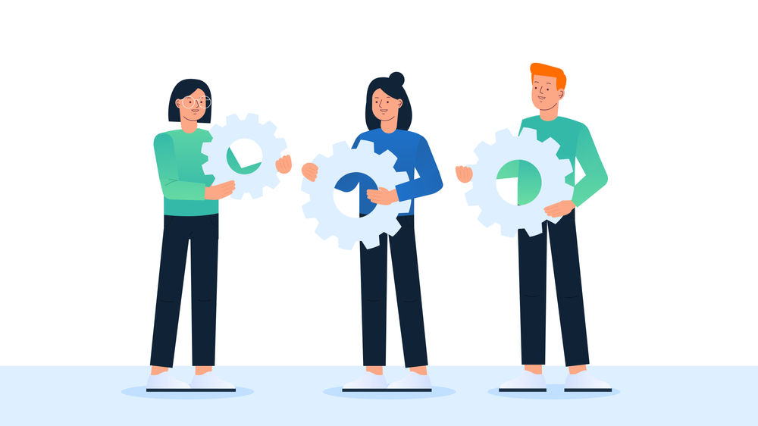
Scrum Development Team
Small team of 1 – 9 people
Self-organized and contains a variety of roles
No titles
Achieves the Sprint goals
Completes the assignments in the Product Backlog

Slide 6
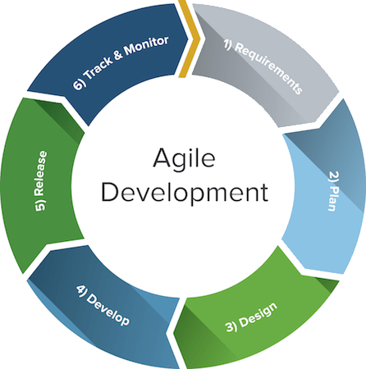
Agile Phases
Main Phases of the Software Development Life Cycle (SDLC)
Planning
Requirements
Design
Development
Testing
Deployment
Maintenance

Slide 7

Planning
Sprint Planning
Meeting takes place prior to a Sprint
Team talks about what User Stories will be taken into a Sprint
Team defines tasks to be implemented to enact a user`s story
Tasks will be divided amongst the team

Slide 8

Requirments
Defined as the project progresses
Deals with the Product Backlog
Prioritizes work
Creates User Stories
Constant updates from the Product Owner

Slide 9

Design, Development, Testing and Deployment
Takes place during a Sprint
Usually last 1-4 weeks and ends with a Sprint Review and Retrospective
Daily Scrums help to keep communication open and to keep a lookout for obstacles
Team presents finished work at the end of every review

Slide 10
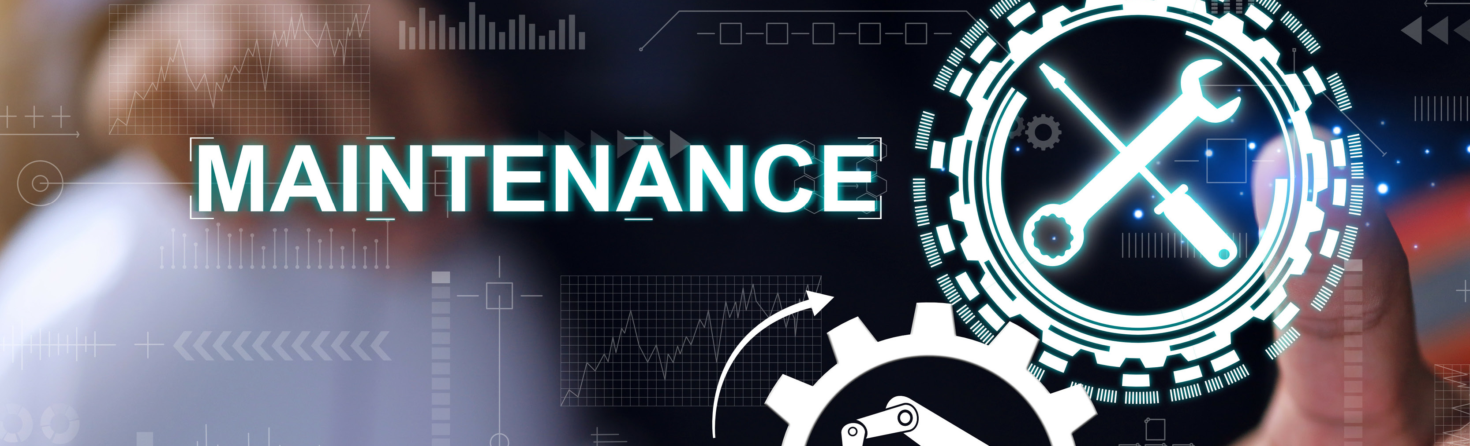
Deployment and Maintenance
Final Sprint Review and Retrospective will be held as to do better for the next Sprint.
Once the product is released and used by the end user. It is considered deployed
The product will be maintained and updated as requested by the customer.

Slide 11
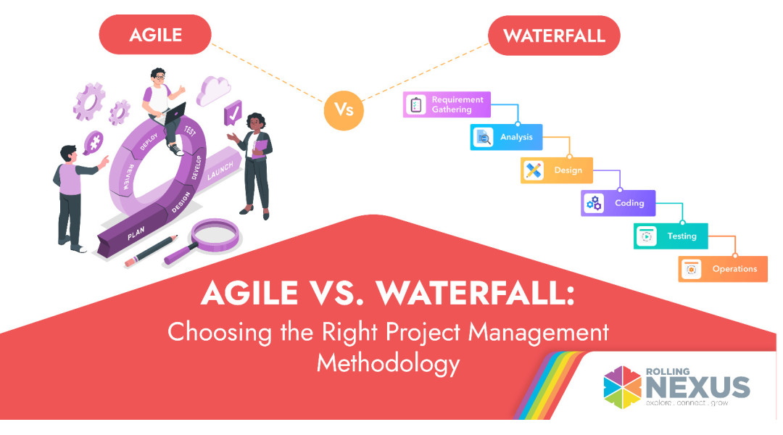

Slide 12
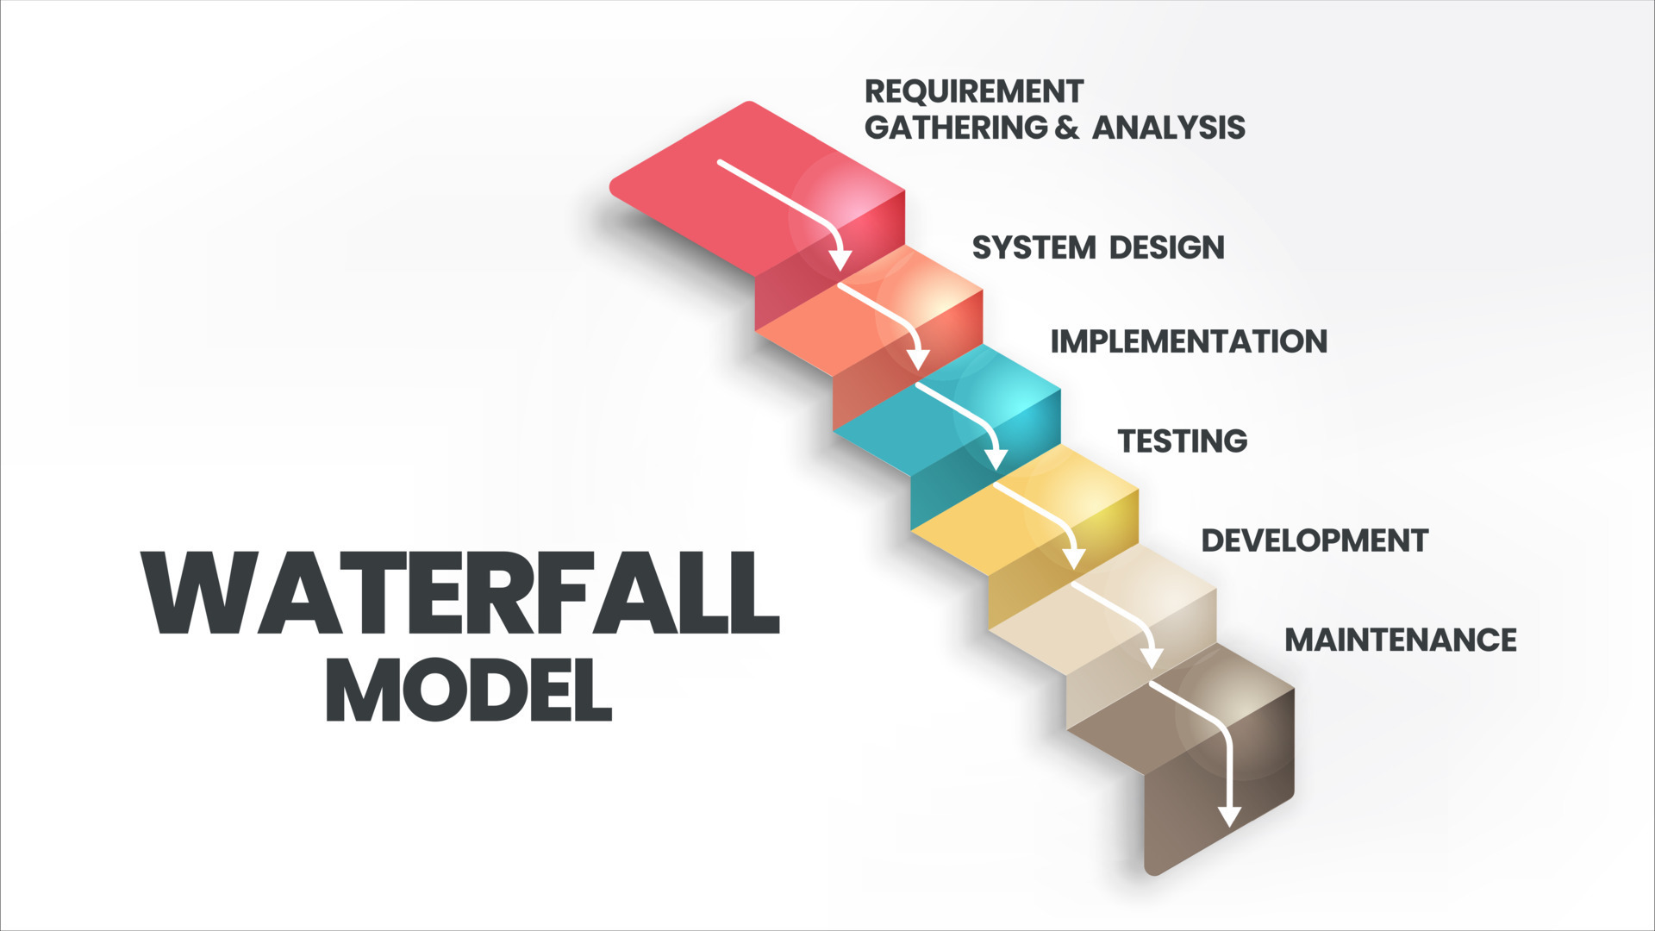
Waterfall Model
Waterfall is a more rigid development structure
plans out each step of the process and implements at the end
Projects are long term and have ridged deadlines
Enacts testing at pre-determined stages of development

Slide 13
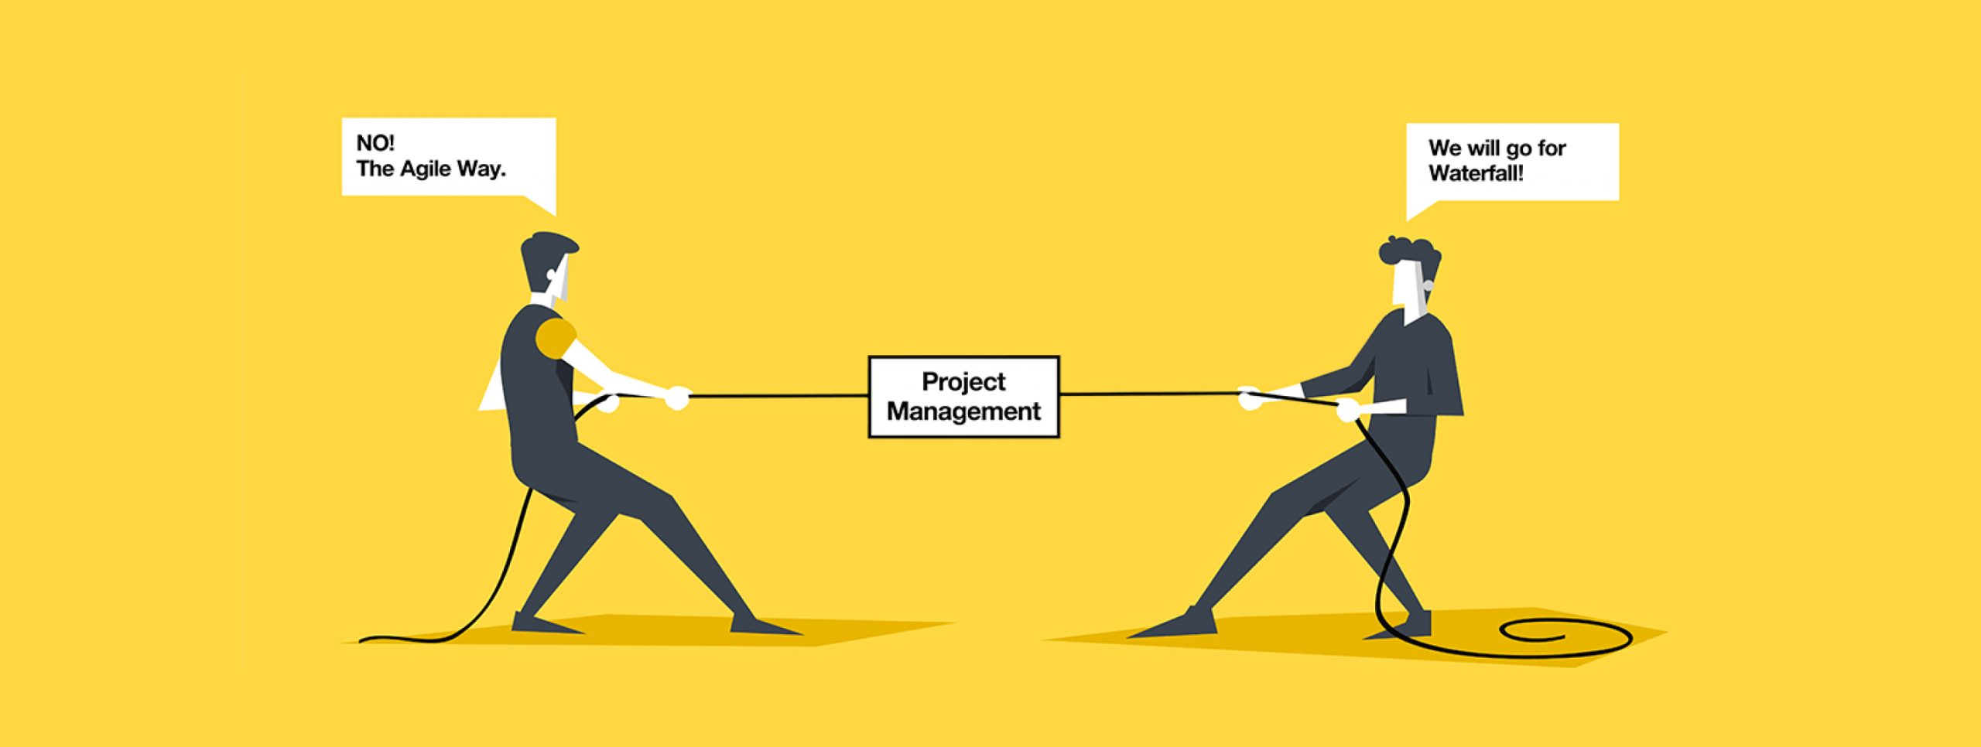
Summary
Waterfall is more ridged and is good for architecting large long-term projects
Waterfall leads to better organized code with little technical debt.
Agile is iterative, flexible and has no rigid structure
Due to no rigid structure, Agile leads to a smoother transition to expanding requirements.
Agile has been known to lead to technical debt

